Slide 1
CLASS 3 and CLASS 4
Dated 20 th JANUARY , 2025
Course Title: 5G and Wireless Technology
Course Code : ECE829
Introduction to 5G Communication
Prof.(Dr.) Rabindranath Bera (Professor, IIIT, KALYANI)
E-mail: rbera@iiitkalyani.ac.in; Mobile : 9475513358

Slide 2
MOTIVATION

Slide 3

5G IOT Use Cases in addition to 5G SMARTPHONE is Progressing at Lighting Speed as shown below:-

Slide 5
ISSUES and SOLUTIONS in 5G COMMUNICATION SYSTEM
Solution towards COVERAGE :
3D TN_NTN CONVERGENCE COMMUNICATION in 6G ERA
[ TN ... Terrestrail Network, NTN .... Non Terrestrail Network Including Satellite ]
Upgradation of 6G Network having 3D COMM ( TN-NTN)
TN CELL ... GREEN and SMALL Circle
SATELLITE NTN CELL ... BLUE and LARGE Circle
Upgradation of UE ( USER EQUIPMENT ) ..6G Mobile
6G TN (UE) can have both TN and NTN Capability
in TN Coverrage area , it will operate as TN UE
in Other Areas, It will operate as NTN UE

Slide 6
THREE Femto TN CELLs with one Satellite (NTN) Cell Design and Proof of Concept at 5G Lab, IIIT KALYANI

Slide 7
* 5G FAPI suite ( femto application platform interface)

Slide 8
Outline of Presentation
The Modern 5G Network: Open and Virtualized RAN
5G SPLIT Architecture
DEMO 1: SYSTEMVUE Simulation : 3GPP NR Beam Acquisition Based On SS/PBCH Blocks
DEMO 2: COGNITIVE RADIO implemented on SONY Cordless Telephone ( Research Work by Prof.
R. Bera and the Group Members)
5G SPLIT Architecture of QUALCOMM 5G TEST BED
5G SPLIT Architecture of IIIT, Kalyani 5G TEST BED with MULTIPLE ( FOUR) RADIO UNITS (RUs)

Slide 9








Slide 10



























































Slide 11










Place processing and analytics where it is needed
Simplify orchestration
Support different deployment scenarios
Resource pooling allows trunking gains and better cost and energy effectiveness
Rapidly scale virtual resources for additional capacity
Higher utilization of scalable resources
Deploy networks faster
with vRAN and
disaggregation
Support lower
end-to-end latency
Components can evolve and be upgraded separately
Open vRAN
Efficiently deploy new services
Tailor dimensioning and features to suit the use case with 5G private networks
Reduce cell-site footprint by relocating disaggregated functions to data centers
Real Estate
Savings
Broaden the
ecosystem for competition
Build RAN cost-effectively
Vendor diversity spurs innovation
3

Slide 12


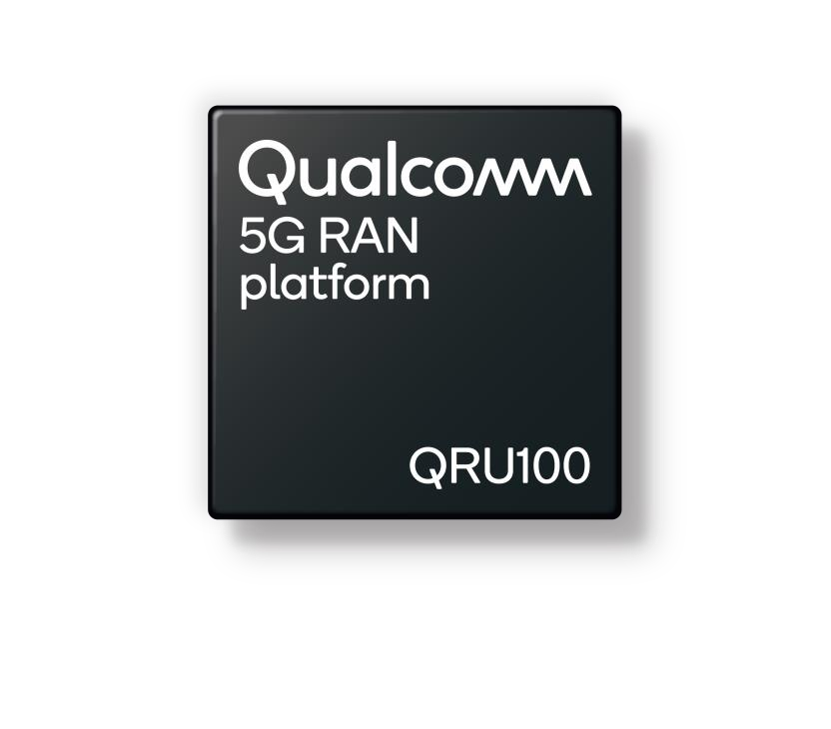
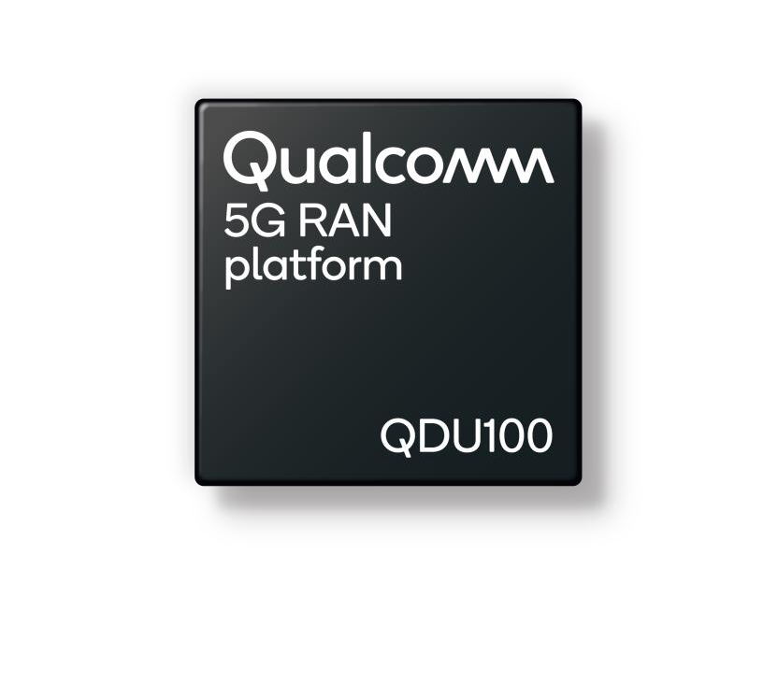
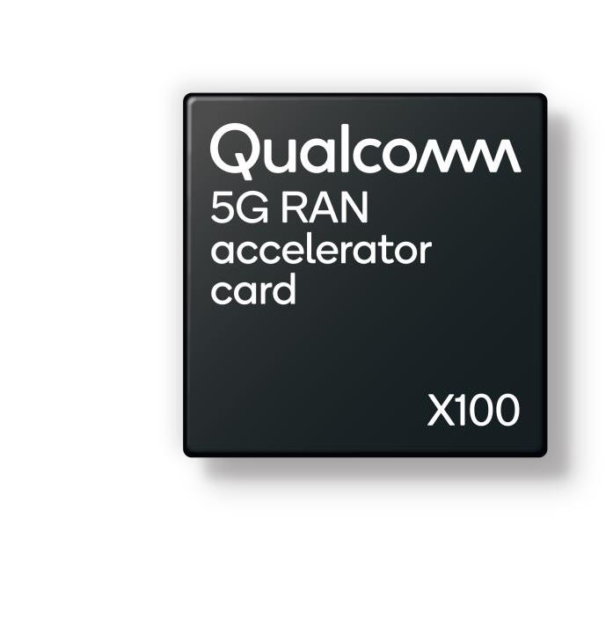




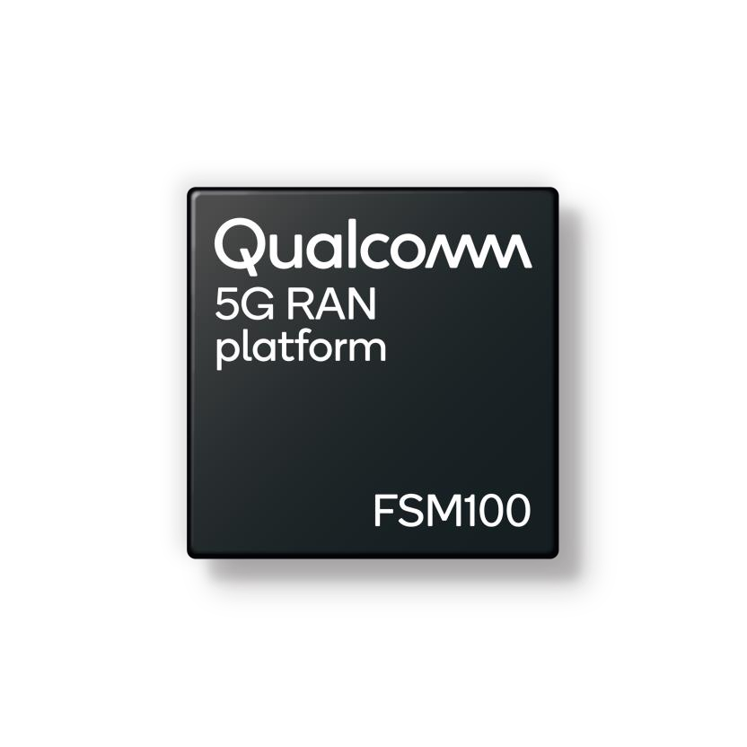





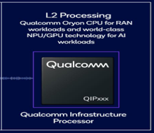



RADIO UNIT
DISTRIBUTED
UNIT
DU in ACC CARD
CODING & MODULATION
SMALL CELLS
AI Processor

Slide 13





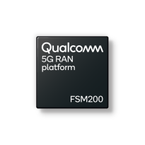

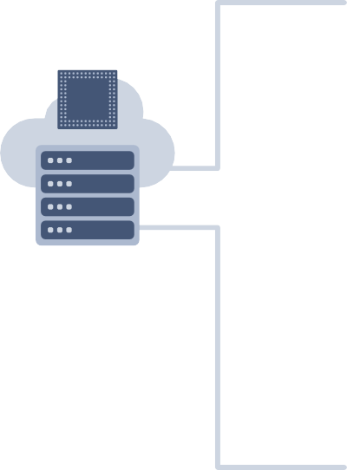


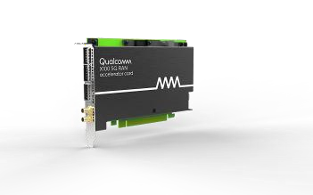



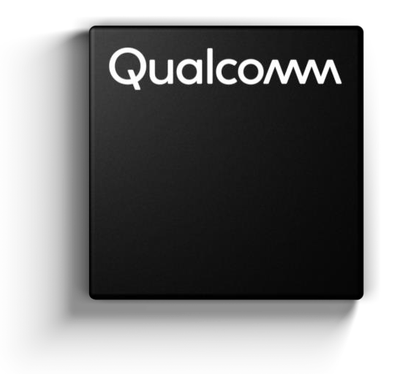





Driving transition to Infrastructure 2.0
Powered by extended portfolio of Qualcomm® 5G RAN platforms
with FOUR PRIVATE CELLS
Standard-based open RAN interfaces
Sub 6 GHz
RADIO
Qualcomm
High-performance Modem-RF System
10101 10101 10101
10100 10100 10100
01010 01010 01010
11010 11010 11010
Virtualized software from multiple vendors
SMALL
CELLs
Internet and 3rd party cloud
Edge data centers
5G-gNB (DU)
with CODING &
MODULATION &
Others
Includes
* 5G CORE
* MEC
General-purpose COTS hardware
EXTREME BROAD BAND using MM Wave RADIO
5G RAN
Platforms
High performance Modem-RF System
Flexible, scalable, O-RAN compatible
vRAN with hardware acceleration
Designed for macro and small cells
Integrated mmWave and Sub-6 GHz solution with
global band support

Slide 14
COMPARE QUALCOMM 5G RAN PLATFORM with INFRA 2.0 with 5G/6G LAB INFRASTRUCTURE , IIIT KALYANI

Slide 15
* 5G FAPI suite ( femto application platform interface)

Slide 16


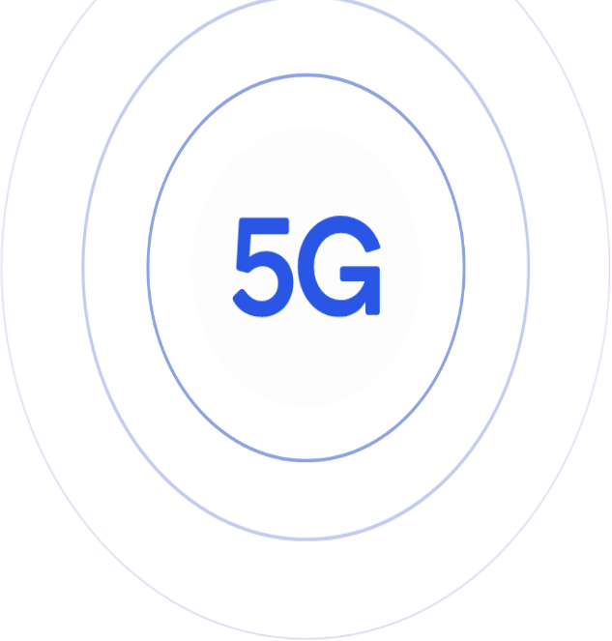








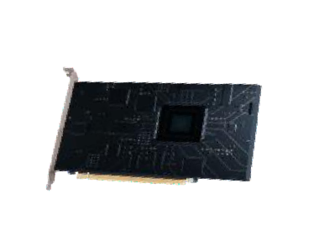












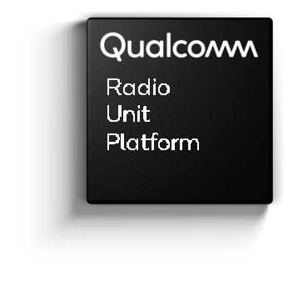











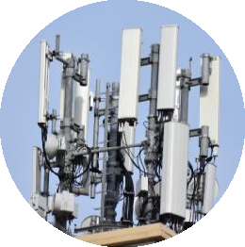
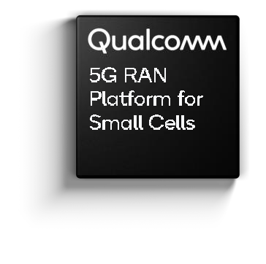











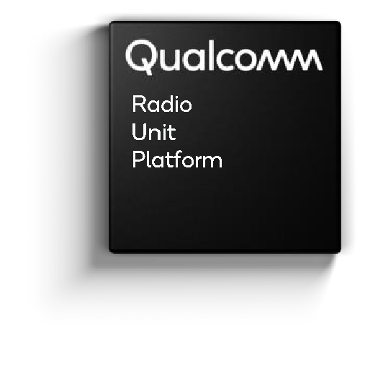



5G Infrastructure 2.0 with PUBLIC & PRIVATE NETWORK ADD-ON
5G OPEN- vRAN PRIVATE NETWORK
ADD-ON
Core Data
Center
RAN Data
Center
RAN Data Center
Small Cells
EXISTING 5G NETWOTK
6

Slide 17













Collaborating with global operators to drive adoption of 5G Open vRAN
7

Slide 18





Driving the evolution to open, virtualized 5G RAN
Announcement recap
Next-generation 5G virtual DU solution
First fully optimized vDU solution with up to 60% lower operator TCO
Solution aims to improve user experiences by helping ready virtualized and open RAN platforms to support the high- capacity and low-latency workloads of future networks.
* Total cost of ownership (TCO)
8

Slide 19
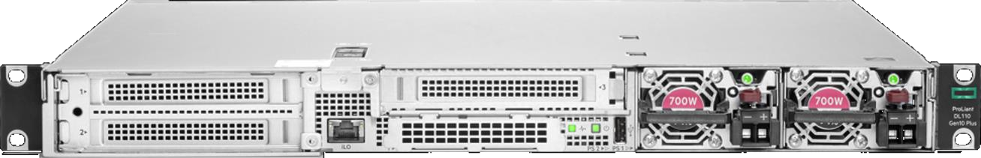

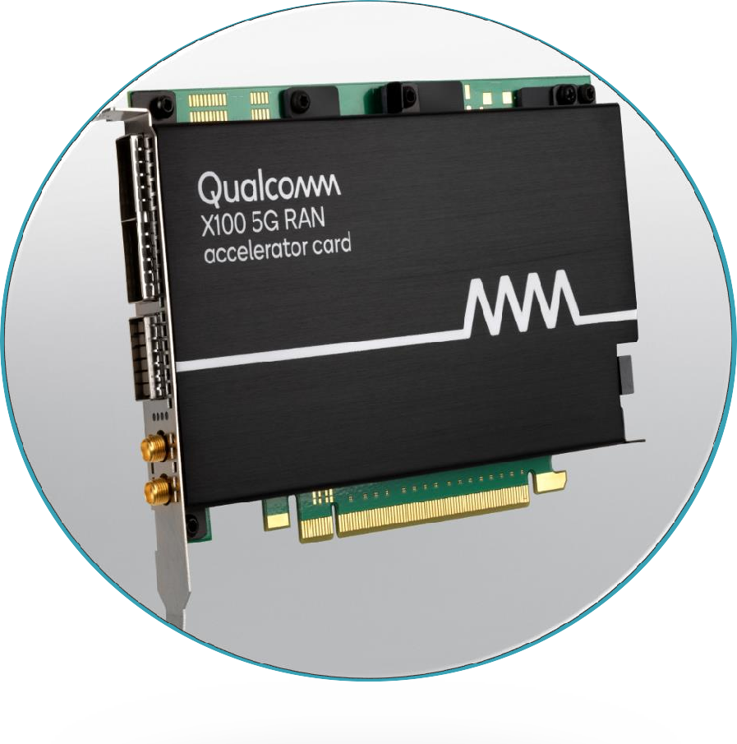



Qualcomm®
HPE ProLiant DL110 Gen10 Plus
X100 5G RAN Accelerator Card
Layer 1 Processing
Demodulation Beamforming Channel coding
Massive MIMO computation
1U server
Up to 4xM.2
NVMe
Front mounting
Front to back
active cooling
Shallow depth 17"
Up to 8 DIMMs
(8–128GB)
4xFHHL x16 PCIe 4.0
Single socket ICX-SP, up to 205W TDP
700W AC/ DC PSU
9

Slide 20
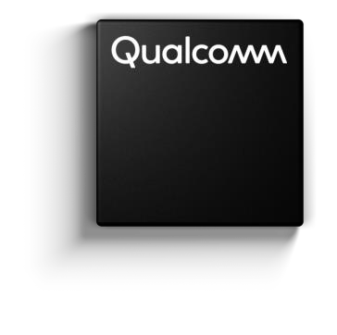






5G RAN
Platform
Next-generation 5G virtual DU solution
up to
up to
60% 40%
First fully optimized vDU solution
Lower Operator TCO
Lower power consumption
Ref : According to a comprehensive joint study by Hewlett Packard Enterprise and Qualcomm Technologies, Inc
10

Slide 21

Driving the evolution to open, virtualized 5G RAN
Announcement recap
Next-generation 5G DUs and RUs with massive MIMO for Open RAN 5G deployments
Solutions to enable the deployment of cloud-native, virtualized, and open 5G networks at scale
Solution Powered by Qualcomm® 5G RAN Platforms is Designed to Simplify Network Deployments, Lower TCO, and Accelerate Adoption of Cloud-Native, Open RAN-Based Mobile Networks Globally
11

Slide 22

Driving the evolution to open, virtualized 5G RAN
Announcement recap
Next-generation 5G DUs and RUs with massive MIMO for Open RAN 5G deployments
Solutions to enable the deployment of cloud-native, virtualized, and open 5G networks at scale
Expanded Open RAN portfolio of 5G Radio Units (RU) spanning categories ranging from mmWave to massive MIMO with 64T64R capabilities to 8T8R radios to drive the transition towards modern networks
12

Slide 23

Driving the evolution to open, virtualized 5G RAN
Announcement recap
Fully-Integrated Open RAN Solution for 5G mmWave
Proliferation
5G mmWave integrated DU and RU for Open RAN 5G deployments
Next-generation mmWave global solution within NTT DOCOMO’s 5G Open RAN Ecosystem (OREC) initiative, ushering in global Open RAN deployments
13

Slide 24
Viettel Launches the World’s First O-RAN 5G Network Utilizing Qualcomm 5G RAN Platforms
Viettel said it will deploy more than 300 sites across various Vietnamese provinces by the first quarter of 2025
Vietnamese telco Viettel announced the commercial launch of its Open RAN (O-RAN) 5G network using a platform provided by Qualcomm Technologies, the company said in a release.
The telco claimed that this is the first O-RAN 5G network utilizing Qualcomm Technologies’ 5G RAN platforms. Viettel said it will deploy over 300 sites across various Vietnamese provinces by the first quarter of 2025, with the potential for thousands more as part of nationwide and international expansion plans in 2025 and beyond, said Viettel.
The deployment utilizes Qualcomm X100 5G RAN Platform for vDUs, Qualcomm QRU100 5G RAN platform for Massive MIMO radio units and integrates the Qualcomm Edgewise Suite for premium RAN management.
https://www.rcrwireless.com/20241114/featured/viettel-qualcomm-5g-o-ran

Slide 25
AI enabled 5G:-
Fueling 5G infrastructure progress with intelligent computing solutions and Open vRAN commercial momentum
Open and virtualized radio access networks (Open vRAN) are gaining momentum with commercial designs and deployments, while intelligent computing innovation and artificial intelligence (AI) are rapidly growing in importance for 5G infrastructure. As a leader in communications and AI technology, Qualcomm Technologies is at the forefront, fueling what’s next for modern 5G networks.
We are adding intelligent computing products to our 5G RAN portfolio, revolutionizing processing, power efficiency and cost-effectiveness. These Arm-compatible processors are designed by Qualcomm Technologies for use in next-generation Open vRAN servers and cost-effective 5G small cells. We are also sharing news about how we, with our customers, are moving Open vRAN forward in a major way — read on for news regarding Viettel, NTT DOCOMO, NEC, Fujitsu and Mavenir.
https://www.qualcomm.com/news/onq/2024/02/fueling-5g-infrastructure-with-intelligent-computing-open-vran

Slide 26
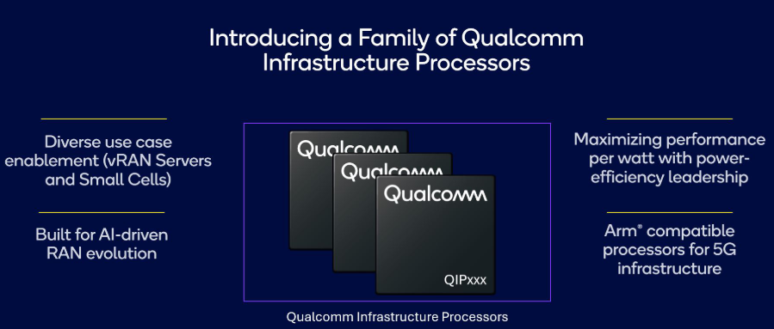
Fueling 5G infrastructure progress with intelligent computing solutions and Open vRAN commercial momentum
https://www.qualcomm.com/news/onq/2024/02/fueling-5g-infrastructure-with-intelligent-computing-open-vran

Slide 27
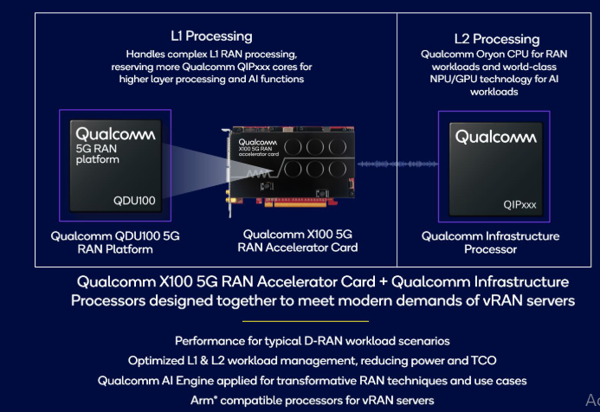
RAN and AI processing innovation for open and virtualized networks
As open and virtualized networks continue to proliferate, in parallel to the expansion of the connected intelligent edge with AI, we are well-positioned to address modern network demands by introducing the Qualcomm Infrastructure Processors for vRAN servers to our portfolio. By leveraging the breakthrough heterogeneous computing capabilities including the Qualcomm Oryon CPU, alongside integrated hardware accelerators (leveraging world-class NPU/GPU technology) and our powerful Qualcomm 5G RAN Platforms, we aim to redefine AI and RAN workload processing in vRAN servers.

Slide 28
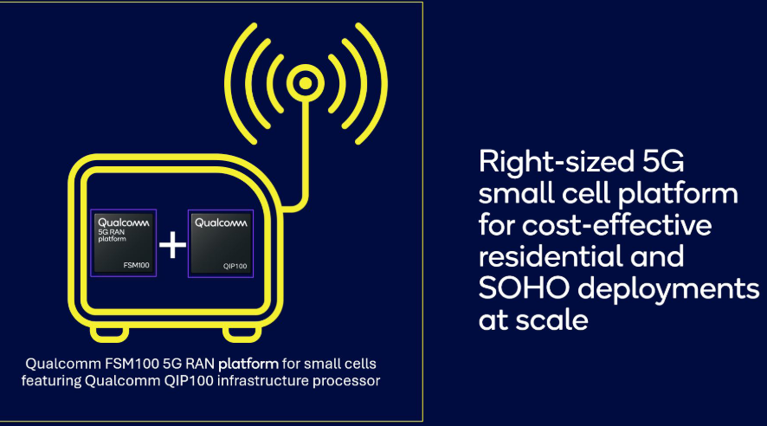
5G small cell innovation with Qualcomm Infrastructure Processors
As a first step, Qualcomm FSM100 5G RAN platform for small cells, now featuring Qualcomm Infrastructure Processor QIP100 for RAN workload processing, is now commercially available. By introducing Qualcomm QIP100, this platform provides a right-sized mix of performance, capacity, power, cost, size and deployment simplicity for residential and SOHO 5G deployments at scale. With this optimized platform, MNOs, working with Qualcomm Technologies’ infrastructure partners, can address growing demand for high-speed, low-latency 5G at home and small office, filling a market gap while creating a viable upgrade path for legacy deployments of 3G and 4G residential small cells (aka femtocells).

Slide 29
Outline of Presentation
The Modern 5G Network: Open and Virtualized RAN
5G SPLIT Architecture
DEMO 1: SYSTEMVUE Simulation : 3GPP NR Beam Acquisition Based On SS/PBCH Blocks
DEMO 2: COGNITIVE RADIO implemented on SONY Cordless Telephone ( Research Work by Prof.
R. Bera and the Group Members)
5G SPLIT Architecture of QUALCOMM 5G TEST BED
5G SPLIT Architecture of IIIT, Kalyani 5G TEST BED with MULTIPLE ( FOUR) RADIO UNITS (RUs)

Slide 30
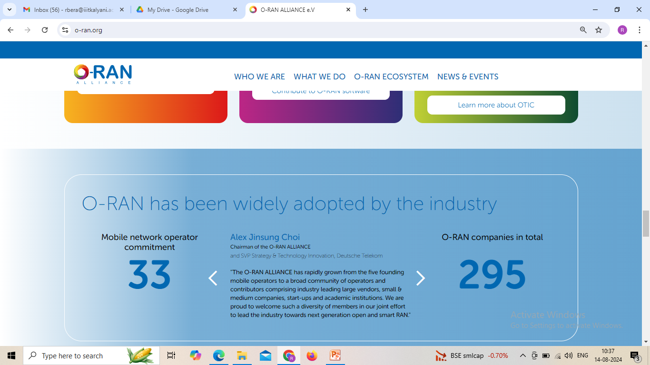

Slide 31
The Open RAN Objective

Slide 32
5G architecture
A: 5G Core consisting of
1. Access and Mobility Function (AMF)
2. User Plane Function (UPF)
B1: 5G node B (gNB) with FAPI residing in the gNB elements
B2: 5G FAPI suite ( femto application platform interface) includes three APIs:
1. PHY API – main data path (P7) and PHY mode control (P5) interface
2. RF and Digital Front End Control API –frontend unit control (P19)
3. Network Monitor Mode NMM API – for 5G/6G (P4)
C: Edge Computing
D: Cloud Computing

Slide 33
5G architecture showing FAPI residing in the gNB elements

Slide 34
5G FAPI suite with
1. PHY API – main data path (P7) and PHY mode control (P5) interface
2. RF and Digital Front End Control API –frontend unit control (P19)
3. Network Monitor Mode NMM API – for 5G/6G (P4)
PHY API
Three categories of procedures use the PHY API, including configuration procedures, slot procedures, and beamforming/RF procedures.
Configuration procedures occur least frequently and handle the general management of the PHY layer.
Slot procedures occur much more frequently; they determine each slot’s structure and operate based on the subcarrier spacing, such as periods of 125us, 250us, 500us, or 1ms.
Beamforming/RF procedures are used for defining precoding and beamforming parameters. They are flexible and are defined in tables loaded into the PHY at configuration time.

Slide 35
Use of 5G FAPI suite with Separate Control Plane ( P5 Interface) and Data Plane ( P7 Interface) in achieving Better Performance in 5G eMBB,URLLC and mIOT use Cases

Slide 36
Analog Beamforming USE CASE to achieve Radio Energy Efficiency using Laser like Antenna Beam
[5G FAPI suite with RF and Digital Front End Control API (P19 Interface) ]

Slide 37
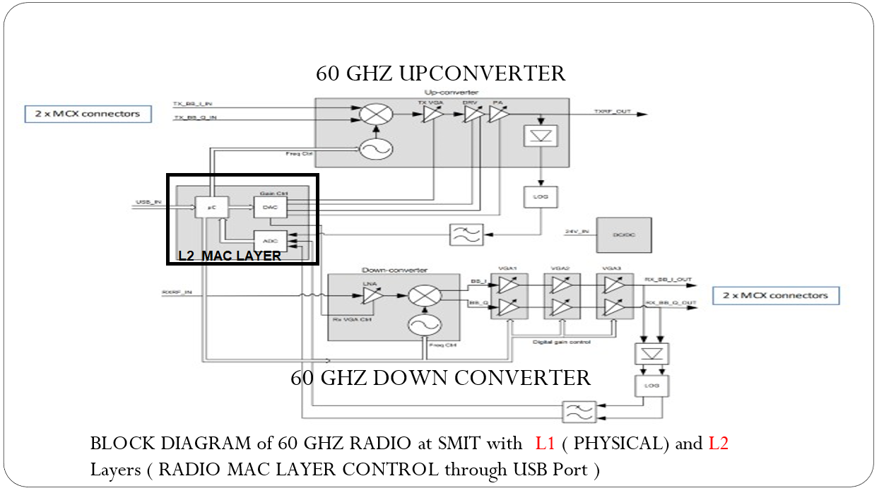
Realization of 60 GHz Small Cell by Prof. R. Bera with PHY API – main data path (P7) and PHY mode control (P5) interface
Fig. BLOCK Diagram of 60 GHZ Evaluation Board Procured at SMIT to realize BI-DIRECTIONAL LINK at SMIT

Slide 39
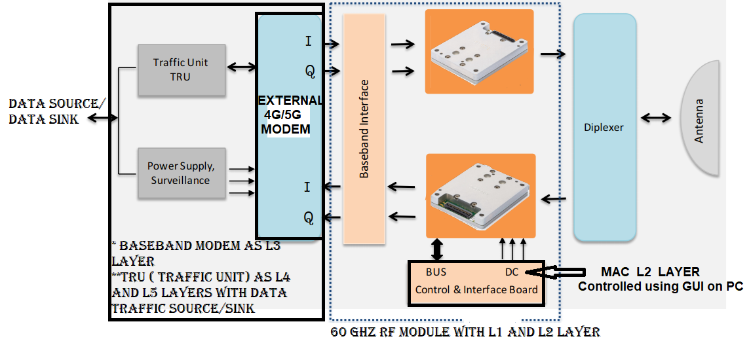
Fig. 9.4 SCHEME of Upgradation of 60 GHz Evaluation Board to 60 GHZ Terminal with 5 Layers
The Upgradation Scheme of 60 GHz Evaluation Board to 60 GHZ Terminal with 5 Layers is depicted in figure 9.4 with addition of follwing Items:-
iv) L1 Physical Layer will be Monitored and Controlled through L2 Layer, USB Port and GUI on PC as shown in figure 9.4
v) Both I Q input and I Q Output are provided for interfacing this Board with an EXTERNAL MODEM as shown in figure 9.4 . In our design, Special efforts are put to interface ‘ Smartphone Modem’ as an external Modem so reduce the design cost.
vi) One TRU ( Traffic Unit) unit as L4 and L5 Layers to be used to increasr data reliability and Data Flow Control using TCP and HTTP Protocol. SMIT has already developed such TRU using Matlab within a PC and passed data over our existing 28 GHz 5GTTH link. Further efforts are put to incorporate into the 60 GHz development by re-using the same concept.

Slide 40
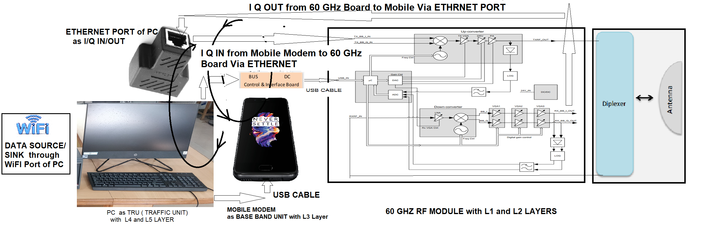
Fig. 9.5 FINAL DESIGN of 60 GHZ LINK TERMINAL
Description of the Final Design of 60 GHZ Terminal
Items Used :-
1. 60 GHz Evaluation Board with Diplexer and Horn Antenna
2. One 4G/5G as SMARTPHONE EXTERNAL MODEM connected to the PC using USB Cable
3. One ALL-IN-ONE HP PAVILLION PC as TRU with L4 and L5 Layers support
4. WiFi within the PC is used as DATA SOURCE / DATA SINK which is available from external WiFi HOTSPOT
5. Ethernet Port of the PC is used as ADC/DAC and used to connect EXTERNAL I Q Input and EXTERNAL I Q OUTPUT of the Evaluation Board

Slide 41
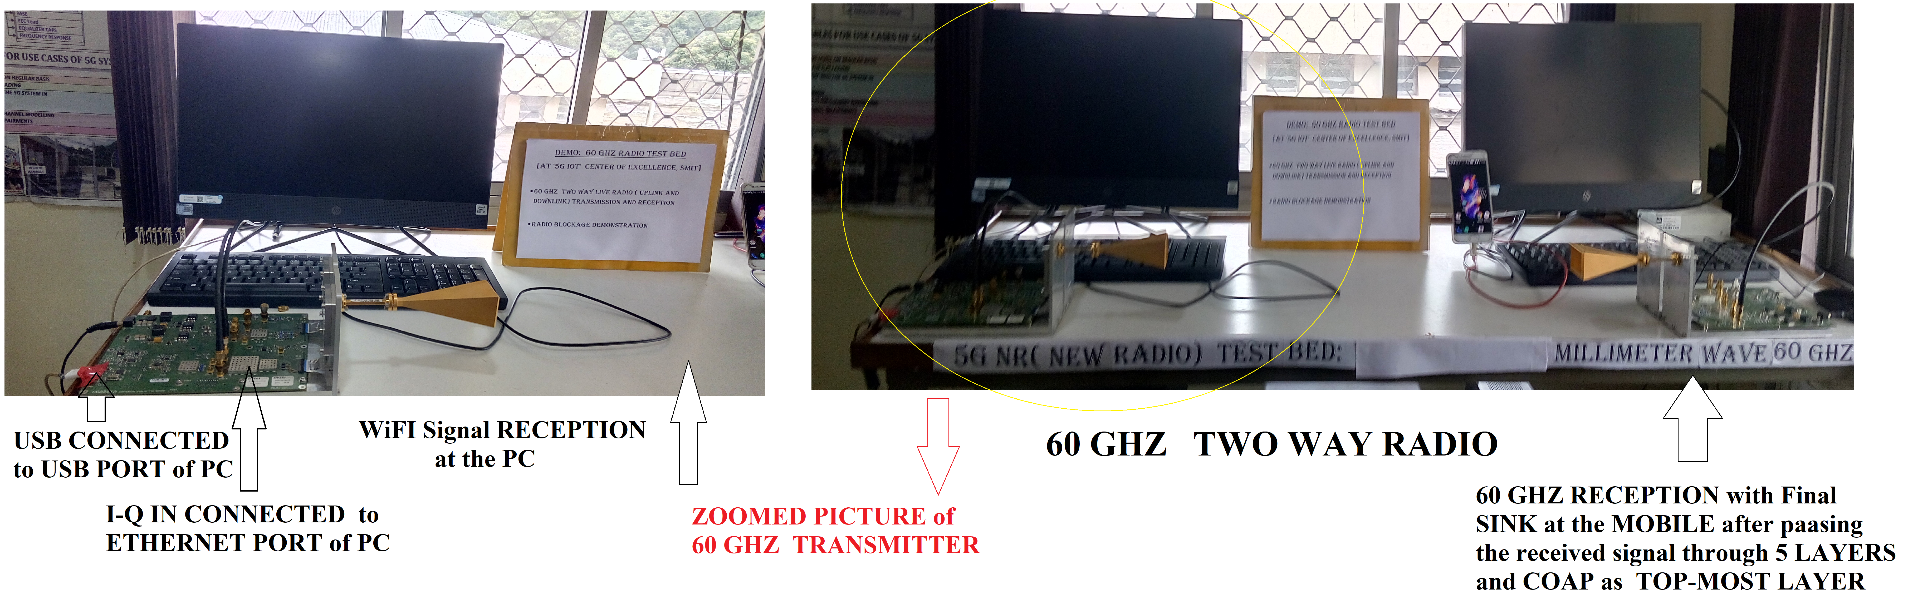
Realization of 60 GHz Small Cell by Prof. R. Bera with PHY API – main data path (P7) and PHY mode control (P5) interface

Slide 42
RF and Digital Front End Control API
In response to the need for close coordination between the front-end unit (FEU) and the stack, 5G FAPI has developed the P19 interface specification dedicated to the control and configuration of the FEU. The use of P19 is different than the interface used in the 4G counterpart specification. The P19 interface specification serves as a companion to the 5G FAPI P5/P7 specification. In addition to supporting fast dynamic control of the FEU, P19 supports network virtualization by allowing stack and FEU solutions from different suppliers to bind together easily. The 5G FAPI approach applies to all-in-one small cell solutions and disaggregated solutions where the upper and lower layers and the FEU may reside at different physical locations.
The capability and flexibility of P19 results from a large set of APIs that allows the upper stack to configure the RF, the DFE, and the ABF blocks in a wide range of configurations and to monitor and adjust various system parameters quickly as required by 5G NR. However, the scope of P19 is limited to the control path. P19 does not mandate the protocols or interface standards for the data flow between the DFE, RF, or the PHY.

Slide 43
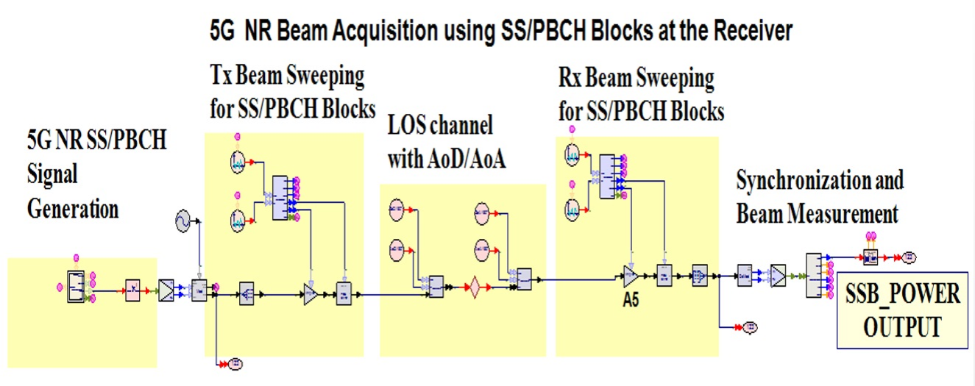
Figure : The model of a 5G NR system, using smart antenna beamforming and beam acquisition that utilizes SS/PBCH signal

Slide 44
DEMO 1: SYSTEMVUE Simulation : 3GPP NR Beam Acquisition Based On SS/PBCH Blocks

Slide 45
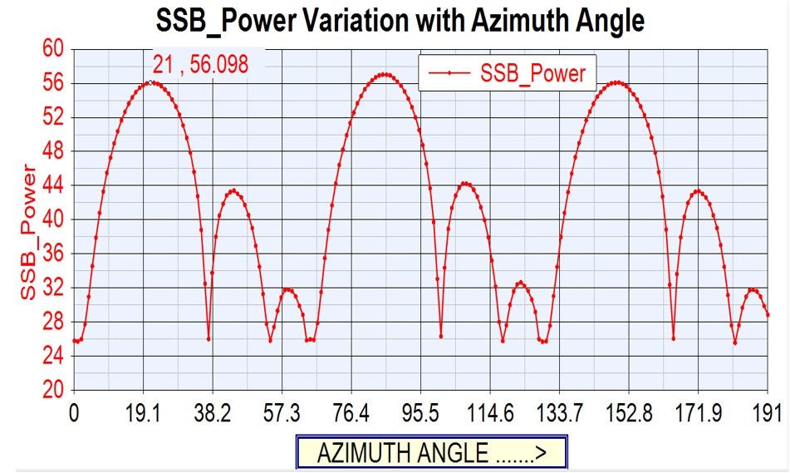
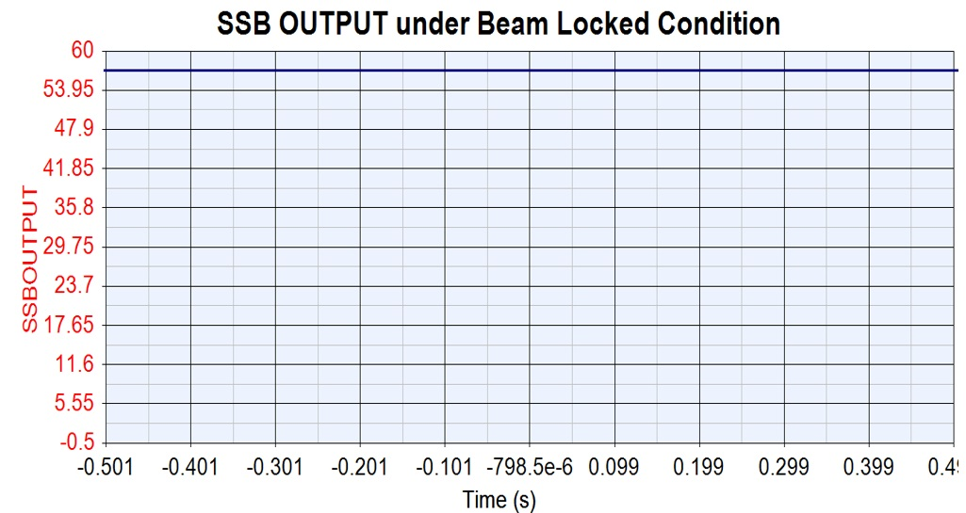
MODE :
TRANSMIT ANTENNA PATTERN measured at 5G Receiver while
Antenna BEAM SWEEPING
MODE :
Synchronization and Beam Measurement
Figure : Recorded DC voltage at the SSB power output from the receiver of 5G NR signal when it is in the beam locked state

Slide 46
COGNITIVE RADIO USE CASE to Combat Radio Interference
with 5G FAPI suite for Network Monitor Mode NMM API (P4 Inteface)
The 5G FAPI suite includes control for self-organizing networks (SON), medium access control (MAC), front end unit including digital front end (DFE), and analog beamforming (ABF) (Image: Small Cell Forum)

Slide 47
What is 5G femto application platform interface (5G FAPI)?
https://www.5gtechnologyworld.com/what-is-5g-femto-application-platform-interface-5g-fapi-faq/
The 5G femto application platform interface (5G FAPI, or simply FAPI) published by the Small Cell Forum (SCF) is a suite of specifications that enable small cells to be built up piece-by-piece using components from different suppliers. It can be viewed as a subset of the network functional application platform interface (nFAPI), also published by the SCF.
Instead of focusing on the delivery of multimedia, 5G NR is designed to be flexible and deliver three types of service, including enhanced mobile broadband (eMBB), ultra-reliable low latency communication (URLLC), and massive internet of things (mIoT). As a result, flexibility is a key feature of 5G NR, and 5G FAPI is designed to support the need for flexibility.
The multiple service types envisioned for 5G NR are causing mobile network operators (MNOs) to look for different cost models that can be optimized based on interoperability and an open and competitive hardware environment.
The disaggregation of networks is making the interface between a distributed unit (DU) for radio functions and a centralized unit (CU) for protocol stacks and baseband functions more critical. As an open specification, FAPI is designed to enable MNOs to mix and match protocol stacks, baseband, and radios from different suppliers, enabling the deployment of disaggregated virtualized radio area network (vRAN) systems.

Slide 48
PHY API
Three categories of procedures use the PHY API, including configuration procedures, slot procedures, and beamforming/RF procedures.
Configuration procedures occur least frequently and handle the general management of the PHY layer.
Slot procedures occur much more frequently; they determine each slot’s structure and operate based on the subcarrier spacing, such as periods of 125us, 250us, 500us, or 1ms.
Beamforming/RF procedures are used for defining precoding and beamforming parameters. They are flexible and are defined in tables loaded into the PHY at configuration time.

Slide 51
Outline of Presentation
5G TEST BED at IIIT KALYANI
DEMO 1 of 5G LAB SET UP AT IIIT KALYANI at ROOM NO G 05
https://drive.google.com/file/d/1mB3v7qXmhT4YCGtggj1umFyQipkE-LyN/view?usp=sharing
Discussion of 5G LAB SET UP AT IIIT KALYANI using 2X2 MIMO Spatial Multiplexed Radio Unit (RU)
SPEEDTEST using a 5G Mobile with POOR Throughput Efficiency due to use of Omni-directional
Antenna Beam ; Maximum Data rate =40 Mbps ( too Poor and Poor Throughput efficiency)
DEMO 2: Discussion on Recent DEMO 2 of 5G by QUALCOMM using MIMO Beamforming
Radio Unit (RU)
DEMO link: https://players.brightcove.net/1414329538001/BJv5wEFt_default/index.html?videoId=6322791358112
Throughput Efficiency =100% due to Laser like Antenna Beam
COMPARE 5G SYSTEM at IIIT KALYANI and QUALCOMM ; Note the difference in ANTENNA
DEMO 3: SYSTEMVUE Software Simulation of MIMO Beamforming Radio Unit (RU) RADIATION PATTERN
TECHNOLOGY TRENDS towards 5G /6G Mobile Communication
5G UNIFIED and 5G SPLIT Architecture
5G UNIFIED Architecture : 5G NR ( New Radio) DL( Downlink) Throughput
DEMO 4: SISO Case using SYSTEMVUE Software Simulation
5G SPLIT Architecture
5G SPLIT Architecture of QUALCOMM 5G TEST BED
DEMO 5: SYSTEMVUE Simulation : 3GPP NR Beam Acquisition Based On SS/PBCH Blocks
DEMO 6: COGNITIVE RADIO implemented on SONY Cordless Telephone ( Research Work by Prof.
R. Bera and the Group Members)
5G SPLIT Architecture of IIIT, Kalyani 5G TEST BED

Slide 52
Network Monitor Mode API (NMM)
The FAPI Network Monitor Mode (NMM) P4 API interface operates and configures network monitoring functions within the PHY(s) capability. The NMM specification defines the procedures, messages, and structures to implement NMM functions for 5G 3GPP release 15 and legacy LTE, UTRAN, GERAN, and NBIoT.
The ability to monitor the radio environment in the vicinity of a small cell and optimize the RAN deployment parameters accordingly is a key factor that enables self-organizing networks (SON). To implement network monitoring, also called network listening, a small cell acts as a passive UE receiver for local RF signals as well as searching and decoding system parameters from nearby cells.
For example, NMM can configure the PHY to scan nearby cells, identify potential reference sources for synchronization, and create a map of the interference spectrum. Typical applications for NMM include SON spectrum sharing deployments in dynamic RF environments that require monitoring and 4G and 5eG SON configurations such as small office and residential environments where network planning overhead can be minimized.

Slide 53
The 5G FAPI suite includes control for self-organizing networks (SON), medium access control (MAC), front end unit including digital front end (DFE), and analog beamforming (ABF) (Image: Small Cell Forum)

Slide 55
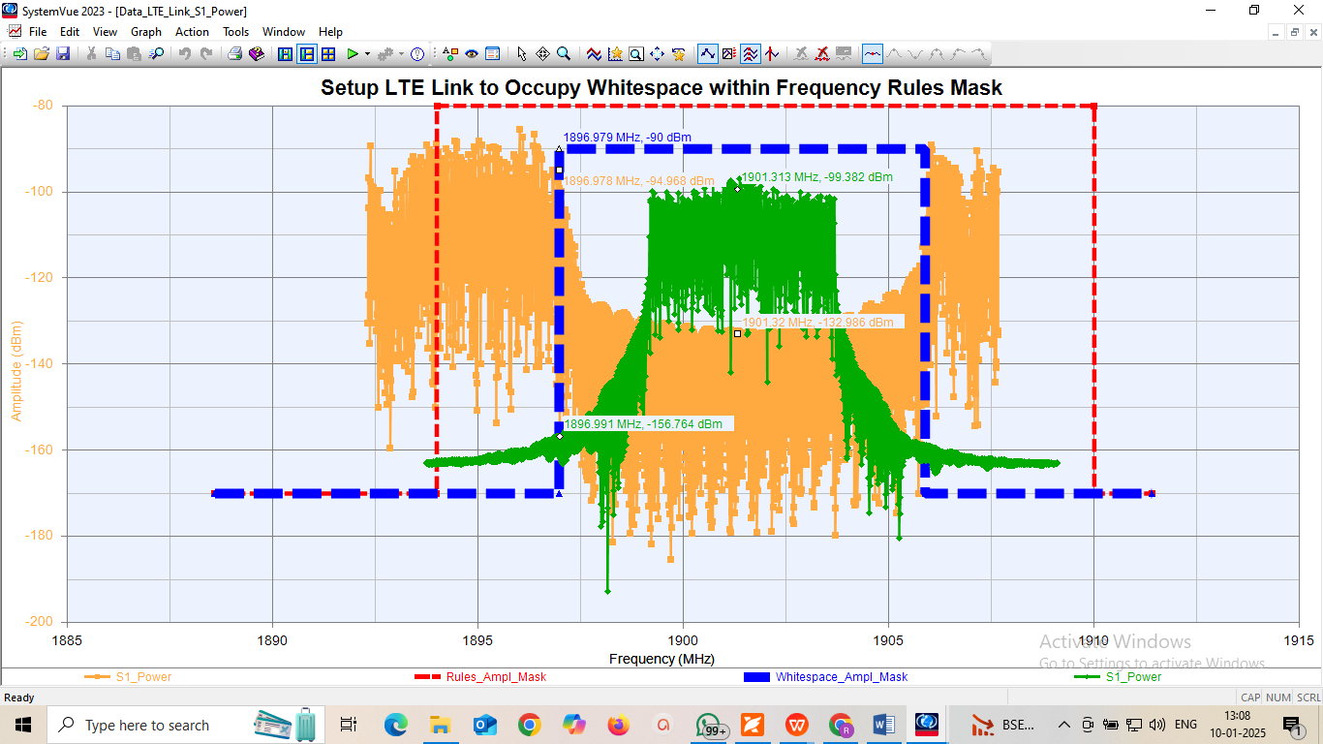

Slide 56

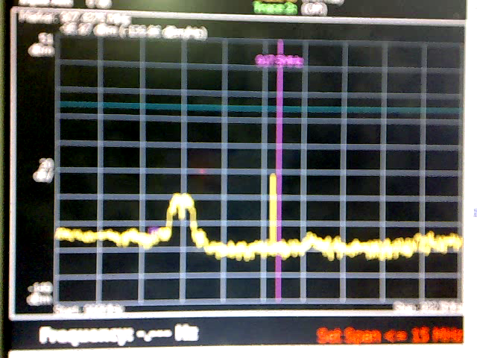
DEMO 2: COGNITIVE RADIO implemented on SONY Cordless Telephone ( Research WOrk by Prof. R. Bera and the Group Members)
Two SPECTURM Shown
SPECTRUM 1 : An Interference SOURCE at LAB ( LINE)
SPECTRUM 2 : Wireless Spectrum ( BROAD BAND)
Wireless HANDSET Cordless BASE STATION

Slide 57
Summary
5G FAPI is a suite of specifications that enable small cells to be built up piece-by-piece using different suppliers’ components. It can be viewed as a subset of the network functional application platform interface (nFAPI). 5G NR is designed to be flexible and deliver three types of service, including enhanced mobile broadband (eMBB), ultra-reliable low latency communication (URLLC), and massive Internet of things (mIoT). As a result, flexibility is a key feature of 5G NR, and 5G FAPI is designed to support that need for flexibility.

Slide 58
Outline of Presentation
5G TEST BED at IIIT KALYANI
DEMO 1 of 5G LAB SET UP AT IIIT KALYANI at ROOM NO G 05
https://drive.google.com/file/d/1mB3v7qXmhT4YCGtggj1umFyQipkE-LyN/view?usp=sharing
Discussion of 5G LAB SET UP AT IIIT KALYANI using 2X2 MIMO Spatial Multiplexed Radio Unit (RU)
SPEEDTEST using a 5G Mobile with POOR Throughput Efficiency due to use of Omni-directional
Antenna Beam ; Maximum Data rate =40 Mbps ( too Poor and Poor Throughput efficiency)
DEMO 2: Discussion on Recent DEMO 2 of 5G by QUALCOMM using MIMO Beamforming
Radio Unit (RU)
DEMO link: https://players.brightcove.net/1414329538001/BJv5wEFt_default/index.html?videoId=6322791358112
Throughput Efficiency =100% due to Laser like Antenna Beam
COMPARE 5G SYSTEM at IIIT KALYANI and QUALCOMM ; Note the difference in ANTENNA
DEMO 3: SYSTEMVUE Software Simulation of MIMO Beamforming Radio Unit (RU) RADIATION PATTERN
TECHNOLOGY TRENDS towards 5G /6G Mobile Communication
5G UNIFIED and 5G SPLIT Architecture
5G UNIFIED Architecture : 5G NR ( New Radio) DL( Downlink) Throughput
DEMO 4: SISO Case using SYSTEMVUE Software Simulation
5G SPLIT Architecture
DEMO 5: SYSTEMVUE Simulation : 3GPP NR Beam Acquisition Based On SS/PBCH Blocks
DEMO 6: COGNITIVE RADIO implemented on SONY Cordless Telephone ( Research Work by Prof.
R. Bera and the Group Members)
5G SPLIT Architecture of QUALCOMM 5G TEST BED
5G SPLIT Architecture of IIIT, Kalyani 5G TEST BED
** https://players.brightcove.net/1414329538001/BJv5wEFt_default/index.html?videoId=6322791358112

Slide 59
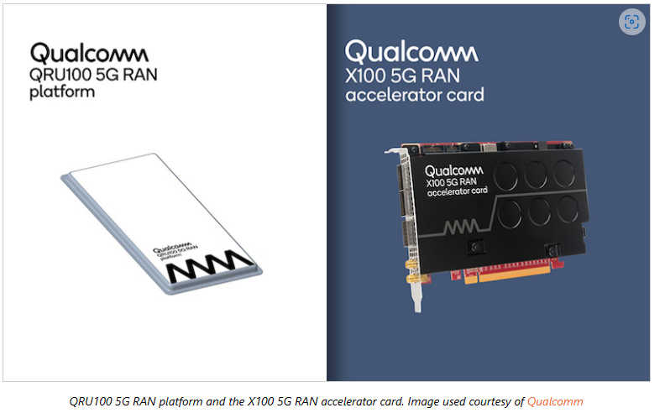
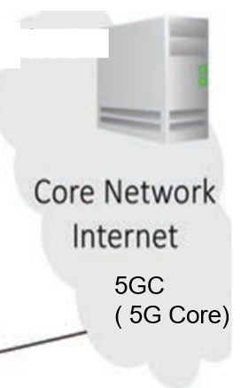
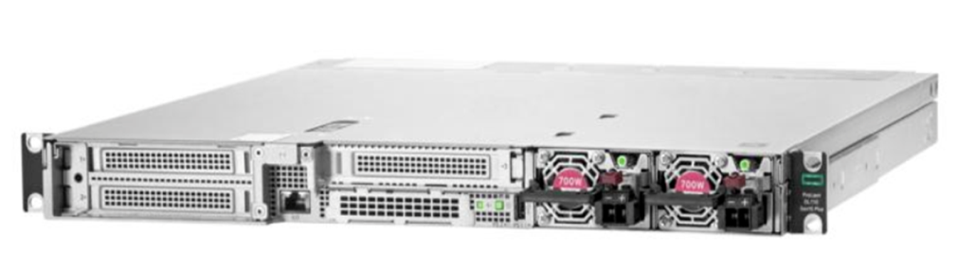

Realization Trends by QUALCOMM :
5G NR-RAN Evolution
NEWS Qualcomm and Vodafone Team for Next-gen 5G O-RAN Effort
November 04, 2022
Qualcomm and Vodafone recently announced that they will collaborate to test and develop infrastructure solutions that will be based on Qualcomm’s Open RAN (O-RAN) devices that are claimed to be energy efficient and high performing: the QRU100 5G RAN Platform, and the X100 5G RAN Accelerator Card. Qualcomm began sampling both cards in Q3 2022.
Vodafone is the leading telecommunications provider in Europe and has publicly committed to improving the environmental sustainability of its networks and brings expertise in large-scale network deployment to the partnership. The company envisions a future network that will support wireless high-bandwidth applications such as virtual and augmented reality.
The two companies plan to unveil more details on their 5G O-RAN infrastructure solution at the World Mobile Conference 2023 in Barcelona.
O_RAN = O_CU + O-DU + O-RU
O_CU:-
HPE ProLiant DL110
Gen10 Plus Telco server
O-DU Card within
PC
O_RU

Slide 60
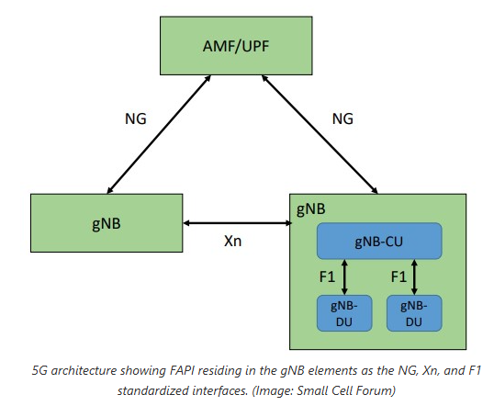

Slide 61
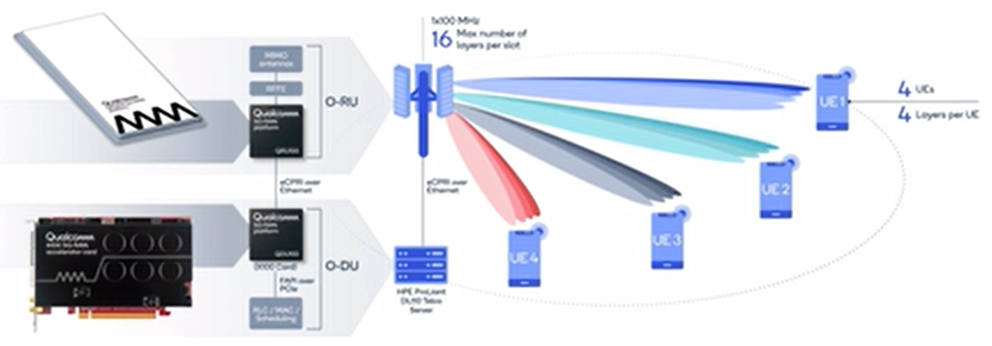

Slide 62
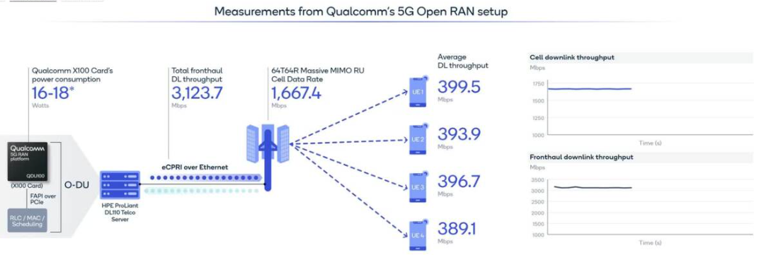
https://www.5gtechnologyworld.com/what-is-5g-femto-application-platform-interface-5g-fapi-faq/

Slide 63
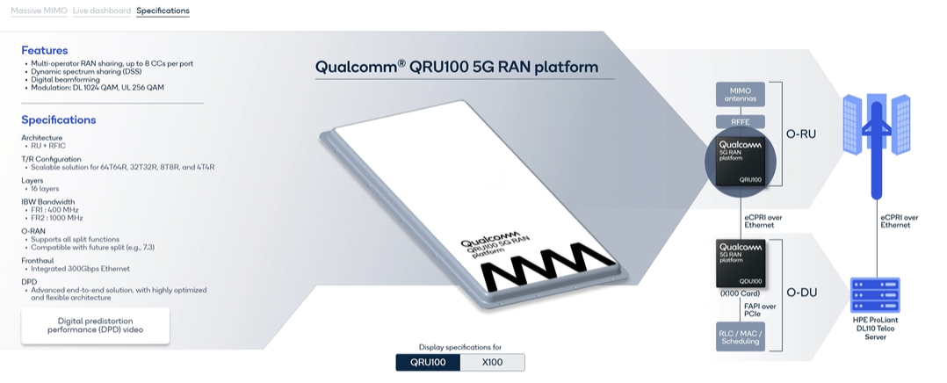

Slide 64
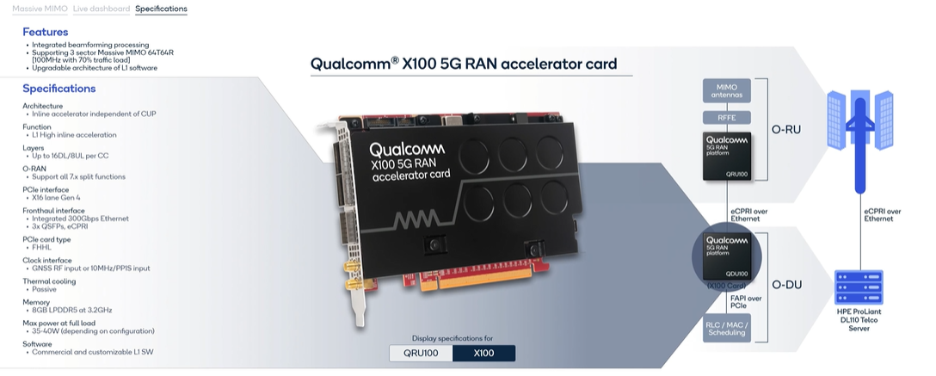

Slide 65

O_CU:-HPE ProLiant DL110 Gen10 Plus Telco server
Overview
Are you ready for 5G?
Customized for edge applications requiring high bandwidth and low latency such as 5G cellular processing (vRAN), the HPE ProLiant DL110 Gen10 Plus Telco server is based on open, standards-compliant infrastructure and offers dense I/O capabilities with PCIe Gen4 speed, acceleration, and powerful compute driven by 3rd Generation Intel® Xeon® Scalable Processors. The HPE ProLiant DL110 Gen10 Plus provides a reduced footprint with a compact, short-depth, 1U/1P front accessible chassis and ruggedized with NEBS Level 3 compliance for harsh environments. [1] Delivering the trusted HPE ProLiant experience with embedded HPE Integrated Lights-Out (iLO) management and security via HPE silicon root of trust, the HPE ProLiant DL110 Gen10 Plus is ready for communication service provider's 5G deployments

Slide 66
Outline of Presentation
5G TEST BED at IIIT KALYANI
DEMO 1 of 5G LAB SET UP AT IIIT KALYANI at ROOM NO G 05 with SINGLE RADIO UNIT (RU)
https://drive.google.com/file/d/1mB3v7qXmhT4YCGtggj1umFyQipkE-LyN/view?usp=sharing
Discussion of 5G LAB SET UP AT IIIT KALYANI using 2X2 MIMO Spatial Multiplexed Radio Unit (RU 1)
SPEEDTEST using a 5G Mobile with POOR Throughput Efficiency due to use of Omni-directional
Antenna Beam ; Maximum Data rate =40 Mbps ( too Poor and Poor Throughput efficiency)
DEMO 2: Discussion on Recent DEMO 2 of 5G by QUALCOMM using MIMO Beamforming
Radio Unit (RU)
DEMO link: https://players.brightcove.net/1414329538001/BJv5wEFt_default/index.html?videoId=6322791358112
Throughput Efficiency =100% due to Laser like Antenna Beam
COMPARE 5G SYSTEM at IIIT KALYANI and QUALCOMM ; Note the difference in ANTENNA
DEMO 3: SYSTEMVUE Software Simulation of MIMO Beamforming Radio Unit (RU) RADIATION PATTERN
TECHNOLOGY TRENDS towards 5G /6G Mobile Communication
5G UNIFIED and 5G SPLIT Architecture
5G UNIFIED Architecture : 5G NR ( New Radio) DL( Downlink) Throughput
DEMO 4: SISO Case using SYSTEMVUE Software Simulation
5G SPLIT Architecture
DEMO 5: SYSTEMVUE Simulation : 3GPP NR Beam Acquisition Based On SS/PBCH Blocks
DEMO 6: COGNITIVE RADIO implemented on SONY Cordless Telephone ( Research Work by Prof.
R. Bera and the Group Members)
5G SPLIT Architecture of QUALCOMM 5G TEST BED
5G SPLIT Architecture of IIIT, Kalyani 5G TEST BED with MULTIPLE ( FOUR) RADIO UNITS (RUs)

Slide 67
THREE Femto TN CELLs with one Satellite (NTN) Cell Design and Proof of Concept at 5G Lab, IIIT KALYANI

Slide 68
* 5G FAPI suite ( femto application platform interface)

